Slide 1
Unintentional Drownings in North Carolina,
2019-2023
Division of Public Health
Data updated March 12, 2025
Notes:
This slide set was created to provide basic data trends and public health surveillance around mortality and morbidity of drownings. They are meant to offer a state-level background on drowning. If you’d like a copy of the slides, please visit the “Drowning and Water Related Injuries” page on our branch website, https://www.dph.ncdhhs.gov/programs/chronic-disease-and-injury/injury-and-violence-prevention-branch. The direct link is also shared at the end of this presentation.
Feel free to incorporate these slides into your own presentations, grant proposals, reports, or any other way they may be useful.
Please read both the speaking and technical notes to ensure that data are presented in a consistent manner.

Slide 2
Unintentional Drowning Technical Notes
Surveillance methods have been updated to identify any mention of an injury in our morbidity data sources. Individual records with multiple injuries listed will be included in the total for each of those injuries but only counted once for overall total injury count. Previously, only the first listed injury was counted, which has resulted in an increase in the number of specific injuries identified.
For questions or for more information see technical notes document available at https://www.injuryfreenc.ncdhhs.gov/DataSurveillance/
Case definitions used:
Deaths – ICD10 codes W65–W74, V90, V92 listed as cause of death
Notes:
For more detailed technical notes on any of the data shared in this slide set, please contact us at InjuryData@dhhs.nc.gov.

Slide 3
Technical Notes, Continued
Hospitalizations – Among records with an ICD-10-CM injury code,* any mention of the following ICD-10-CM codes (includes records resulting in death)
Emergency Department Visits – Any mention of the following ICD-10-CM codes: (includes records resulting in hospitalization or death)
T75.1 | Drowning and nonfatal submersion
V90 | Drowning and submersion due to accident to watercraft
V92 | Drowning and submersion due to accident on board watercraft, without accident to watercraft
W16 with 6th character = 1 | Fall, jump, or diving into water causing drowning and submersion
W22.041 | Striking against wall of swimming pool causing drowning and submersion
W65-W74 | Accidental non-transport drowning and submersion
Y21 | Drowning and submersion, undetermined intent
*See technical notes document for a full list of ICD-10-CM injury diagnosis codes
Notes:
For more detailed technical notes on any of the data shared in this slide set, please contact us at InjuryData@dhhs.nc.gov.

Slide 4
Unintentional drowning-related deaths are the tip of the iceberg
591
Deaths
Despite NC’s excellent reporting systems, the total burden of drowning injury in the state is
unknown.
115
Hospitalizations
554
Deaths
Hospitalizations
ED Visits
ED Visits
? EMS
? Outpatient Visits
? Medically Unattended Injuries
? Medically Unattended Injuries
INJURY ICEBURG
Limited to NC Residents, 2019-2023
Source: NC State Center for Health Statistics, Vital Statistics – Deaths (2019-2023) and Hospitalization Discharge Data (2019-2023); NC DETECT (2019-2023)
Analysis by Injury Epidemiology and Surveillance Unit
Notes:
From 2019-2023, there were 591 deaths, 115 hospitalizations, and 554 emergency department visits associated with unintentional drowning injuries in North Carolina. However, this is just the tip of the iceberg and the total burden of unintentional drowning injury in North Carolina is unknown.

Slide 5

Unintentional Drowning Deaths

Slide 6
Unintentional drowning-related deaths have increased over the last 10 years
16%
increase
Limited to NC Residents, 2019-2023
Source: NC State Center for Health Statistics, Vital Statistics – Deaths (2019-2023)
Analysis by Injury Epidemiology and Surveillance Unit
Notes:
The number of unintentional drowning-related deaths in North Carolina has increased by 16% over the past 10 years (2014-2023).

Slide 7
Unintentional drowning-related deaths impact those of all ages
Limited to NC Residents, 2019-2023
Source: NC State Center for Health Statistics, Vital Statistics – Deaths (2019-2023)
Analysis by Injury Epidemiology and Surveillance Unit
Notes:
Unintentional drowning deaths impact individuals at all ages.

Slide 8
Unintentional drowning death rates are highest among those ages 1 to 4 years old
*The number of deaths was too small to support a rate calculation for infants younger than one.
Limited to NC Residents, 2019-2023
Source: NC State Center for Health Statistics, Vital Statistics – Deaths (2019-2023)
Analysis by Injury Epidemiology and Surveillance Unit
Notes:
The unintentional drowning death rate is highest among young children ages 1-4 years old (2.4 per 100,000).

Slide 9
Most unintentional drowning-related deaths occurred among men and non-Hispanic Whites
Limited to NC Residents, 2019-2023
Source: NC State Center for Health Statistics, Vital Statistics – Deaths (2019-2023)
Analysis by Injury Epidemiology and Surveillance Unit
Notes:
From 2019-2023, most unintentional drowning deaths occurred among men (n=474) and non-Hispanic White residents (n=338).

Slide 10
Rates of unintentional drowning-related deaths were highest among men and non-Hispanic American Indians / Alaska Natives
Limited to NC Residents, 2019-2023
Source: NC State Center for Health Statistics, Vital Statistics – Deaths (2019-2023)
Analysis by Injury Epidemiology and Surveillance Unit
Notes:
However, the rate of unintentional drowning deaths from 2019-2023 was highest among men (1.83 per 100,000) and non-Hispanic American Indian/Alaska Native individuals (1.97 per 100,000).

Slide 11
Unintentional drownings were highest in the summer months, with nearly 1 in 5 occurring in July
Limited to NC Residents, 2019-2023
Source: NC State Center for Health Statistics, Vital Statistics – Deaths (2019-2023)
Analysis by Injury Epidemiology and Surveillance Unit
Notes:
The largest percentage of unintentional drowning deaths occur in the summer months. From 2019-2023, 17% of these deaths occurred in July.

Slide 12
Over half of unintentional drownings occur in natural water
Limited to NC Residents, 2019-2023
Source: NC State Center for Health Statistics, Vital Statistics – Deaths (2019-2023)
Analysis by Injury Epidemiology and Surveillance Unit
Notes:
By water source, 54% of unintentional drowning deaths occurred in natural water (2019-2023), followed by bathtub and swimming pool (both 16%).

Slide 13
Unintentional drowning deaths vary by water source and age group
Limited to NC Residents, 2019-2023
Source: NC State Center for Health Statistics, Vital Statistics – Deaths (2019-2023)
Analysis by Injury Epidemiology and Surveillance Unit
Notes:
Unintentional drowning deaths varied by water source and age group (2019-2023). For younger ages, less than 5 years old, most deaths occurred in a swimming pool. For older ages, most deaths occurred in natural bodies of water.

Slide 14
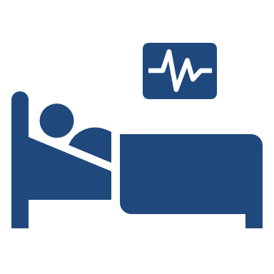
Unintentional Near-Drowning
Hospitalizations

Slide 15
Unintentional drowning-related hospitalizations decreased over the last five years
37%
decrease
Limited to NC Residents, 2019-2023
Source: NC State Center for Health Statistics, Hospital Discharge Data (2019-2023)
Analysis by Injury Epidemiology and Surveillance Unit
Notes:
The number of unintentional drowning-related hospitalizations decreased by 37% of the last five years (2019-2023).

Slide 16
Unintentional drowning-related hospitalizations are most common among those ages 1 to 4
Limited to NC Residents, 2019-2023
Source: NC State Center for Health Statistics, Hospital Discharge Data (2019-2023)
Analysis by Injury Epidemiology and Surveillance Unit
Notes:
Unintentional drowning-related hospitalizations were most common among young children ages 1 to 4 years old, with 37 visits in 2019-2023.

Slide 17
Children ages 1 to 4 have the highest rates of unintentional drowning-related hospitalizations
*The number of hospitalizations was too small to support a rate calculation for adults ages 55-64.
Limited to NC Residents, 2019-2023
Source: NC State Center for Health Statistics, Hospital Discharge Data (2019-2023)
Analysis by Injury Epidemiology and Surveillance Unit
Notes:
Likewise, children ages 1 to 4 years old had the highest rate of unintentional drowning-related hospitalizations from 2019-2023 with 1.53 per 100,000.

Slide 18
Most unintentional drowning-related hospitalizations occurred among men and non-Hispanic Whites
NH – non-Hispanic
Limited to NC Residents, 2019-2023
Source: NC State Center for Health Statistics, Hospital Discharge Data (2019-2023)
Analysis by Injury Epidemiology and Surveillance Unit
Notes:
The majority of unintentional drowning-related hospitalizations occurred among men (n=78) and non-Hispanic White residents (n=62) from 2019-2023.

Slide 19
Unintentional drowning-related hospitalization rates were highest among men and non-Hispanic Asians
NH – non-Hispanic; *The number of hospitalizations was too small to support a rate calculation for NH American Indian.
Limited to NC Residents, 2019-2023
Source: NC State Center for Health Statistics, Hospital Discharge Data (2019-2023)
Analysis by Injury Epidemiology and Surveillance Unit
Notes:
From 2019-2023, the groups with the highest rate of unintentional drowning-related hospitalizations males (0.30 per 100,000) and non-Hispanic Asian residents (0.28 per 100,000).

Slide 20

Unintentional Near-Drowning
Emergency Department Visits

Slide 21
Unintentional drowning-related ED visits decreased by 13% over the last five years
13%
decrease
Limited to NC Residents, 2019-2023
Source: NC DETECT (2019-2023)
Analysis by Injury Epidemiology and Surveillance Unit
Notes:
The number of unintentional drowning-related emergency department (ED) visits decreased by 13% over the last five years (2019-2023).

Slide 22
37.7% of unintentional drowning-related ED visits occurred among children younger than 10
Limited to NC Residents, 2019-2023
Source: NC DETECT (2019-2023)
Analysis by Injury Epidemiology and Surveillance Unit
Notes:
37.7% of unintentional drowning-related ED visits occurred among children younger than 10 years old (2019-2023).

Slide 23
Children ages 1 to 4 have the highest rates of unintentional drowning-related ED Visits
Limited to NC Residents, 2019-2023
Source: NC DETECT (2019-2023)
Analysis by Injury Epidemiology and Surveillance Unit
Notes:
From 2019-2023, children ages 1 to 4 years old had the highest rate of unintentional drowning-related ED visits (5.7 per 100,000).

Slide 24
Most unintentional drowning-related ED visits occurred among men and non-Hispanic Whites
NH – non-Hispanic
Limited to NC Residents, 2019-2023
Source: NC DETECT (2019-2023)
Analysis by Injury Epidemiology and Surveillance Unit
Notes:
From 2019-2023, the groups with the highest number of unintentional drowning-related ED visits occurred among men and non-Hispanic White individuals.

Slide 25
Rates of unintentional drowning-related ED visits were highest among men and non-Hispanic Whites
NH – non-Hispanic; *The number of hospitalizations was too small to support a rate calculation for NH American Indians and NH Asians.
Limited to NC Residents, 2019-2023
Source: NC DETECT (2019-2023)
Analysis by Injury Epidemiology and Surveillance Unit
Notes:
From 2019-2023, the groups with the highest rate of unintentional drowning-related ED visits occurred among men (1.3 per 100,000) and non-Hispanic White North Carolina residents (1.2 per 100,000).

Slide 26
Unintentional near-drownings occur in a variety of water sources
Limited to NC Residents, 2019-2023
Source: NC DETECT (2019-2023)
Analysis by Injury Epidemiology and Surveillance Unit
Notes:
Half of unintentional drowning-related ED visits were for unspecified (26.0%) or other (24.4%) reasons. The highest percentages of visits mentioning specific water sources were swimming pool, watercraft, and natural water-related.

Slide 27
Summary of unintentional drowning-related injuries in North Carolina, 2019-2023
From 2019-2023, unintentional drowning-related injuries resulted in:
  Nearly 600 deaths
  Almost 120 hospitalizations
  Nearly 600 emergency department visits
Unintentional drowning-related death rates are highest among men and non-Hispanic American Indians / Alaska Natives
Rates of unintentional drowning-related injuries are highest in children ages 1 to 4 years old
Notes:
From 2019-2023, unintentional drowning resulted in nearly 600 deaths, almost 120 hospitalizations and nearly 600 ED visits. Unintentional drowning-related death rates were highest among men and non-Hispanic American Indian/Alaska Natives. Rates of unintentional drowning-related injuries were highest among children ages 1 to 4 years old.

Slide 28
Unintentional drownings are preventable
Top Safety Tips
  Watch children when they are in or around water
  Teach yourself and children to swim
  Learn CPR and basic rescue skills
    Learn how to perform CPR on children and adults
  Ensure swimming pools have 4-sided fencing at least 4 feet high
Notes:
Tips to prevent drownings include watching children when around water, teaching yourself and children to swim, learning CPR, and ensuring swimming pools are enclosed with fences at least 4 feet tall.

Slide 29
Resources
Safe Kids North Carolina
  https://www.ncosfm.gov/community-risk-reduction/safe-kids
Division of Public Health, Injury and Violence Prevention Branch
  https://www.dph.ncdhhs.gov/programs/chronic-disease-and-injury/injury-and-violence-prevention-branch
Centers for Disease Control and Prevention: Drowning Prevention
  https://www.cdc.gov/drowning/about/
National Drowning Prevention Alliance
  https://ndpa.org/
US Consumer Product Safety Commission – Pool Safety
  https://www.poolsafely.gov/
Notes:
For more information on drowning prevention, please visit the linked sites.

Slide 30
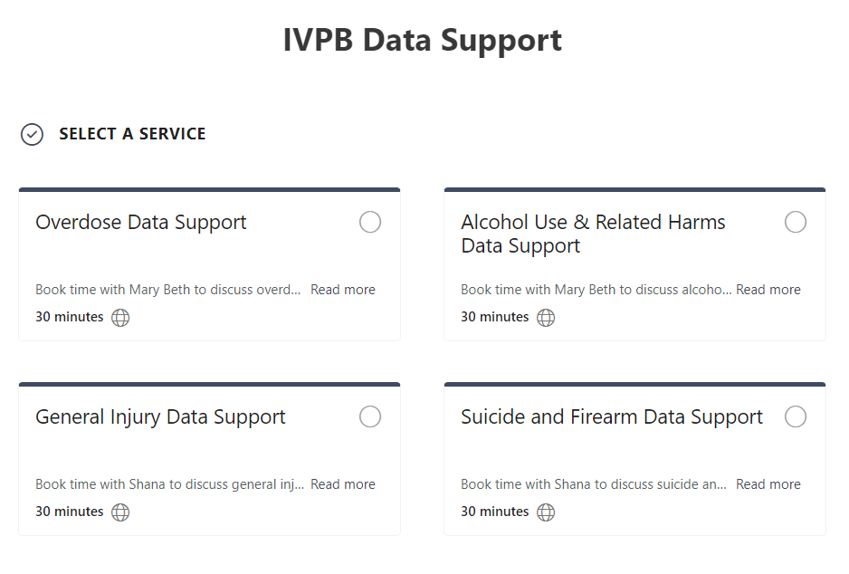

IVPB Data Support now available!
Book time with an IVPB epidemiologist to discuss available data products, to talk through custom data requests, or for general data questions.
IVPB Data Request Policy
IVPB Data Support Bookings

Slide 31
Questions?
InjuryData@dhhs.nc.gov
Injury and Violence Prevention Branch
Division of Public Health
www.dph.ncdhhs.gov/programs/chronic-disease-and-injury/injury-and-violence-prevention-branch

